Slide 1
AP & GP

Slide 2
Arithmetic Progression:
Arithmetic Progression(AP) or arithmetic sequence is a sequence of numbers in which each term after the first is obtained by adding a constant, d to the preceding term. The constant d is called common difference.
An arithmetic progression can be given by a,(a+d),(a+2d),(a+3d),⋯
where a = first term, d = common difference
a, b, c are in AP, 2b = a + c

Slide 3


n th term of an Arithmetic Progression tn=a+(n−1)d
where tn=nth term, a = the first term, d = common difference
Number of Terms of an Arithmetic Progression
where n = number of terms, a = the first term, l = last term, d = common difference
Sum of First n Terms of an Arithmetic Progression

Slide 4

Additional Hints on AP
To solve most of the problems related to AP, the terms can be conveniently taken as
3 terms: (a−d),a,(a+d)
4 terms: (a−3d),(a−d),(a+d),(a+3d)
5 terms: (a−2d),(a−d),a,(a+d),(a+2d)
$$t_{n}=S_{n}−S_{n}−1$$

Slide 5
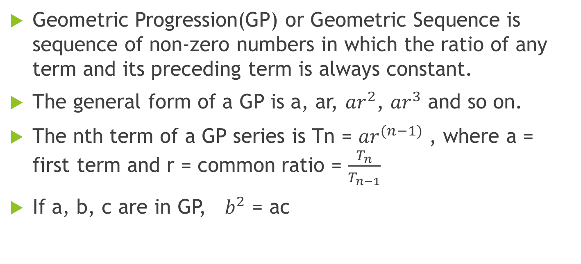
Geometric Progression:
Geometric Progression(GP) or Geometric Sequence is sequence of non-zero numbers in which the ratio of any term and its preceding term is always constant.
The general form of a GP is a, ar, ${ar}^{2}$, ${ar}^{3}$ and so on.
The nth term of a GP series is Tn = ${ar}^{(n−1)}$ , where a = first term and r = common ratio = $\frac{T_{n}}{T_{n−1}}$
If a, b, c are in GP, $b^{2}$ = ac

Slide 6
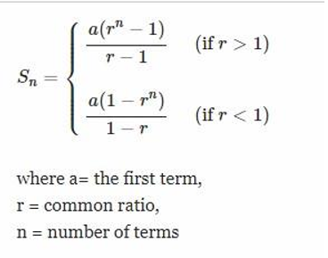
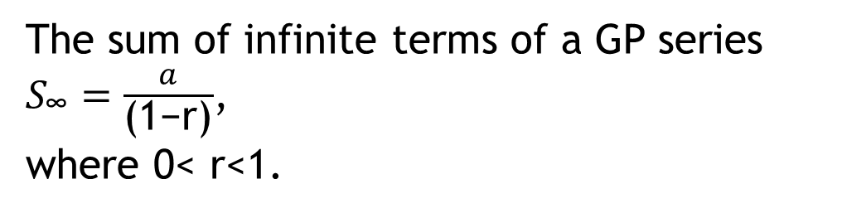
Sum of First n Terms of a Geometric Progression
The sum of infinite terms of a GP series $S_{\text{∞}}=\frac{a}{\text{(1−}\text{r}\text{)}}$,
where 0< r<1.

Slide 7
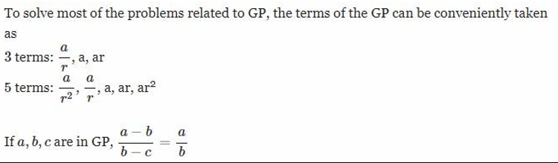
Additional Hints on GP :

Slide 8
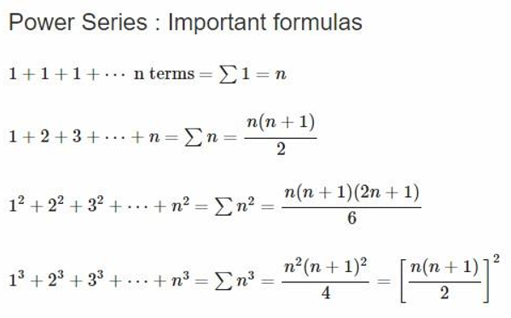

Harmonic progression:
A series of terms is known as a HP series when their reciprocals are in arithmetic progression.
The $n^{th}$ term of a HP series is $t_{n}$ = $\frac{1}{\text{[}\text{a}\text{ + (}\text{n}\text{ −1) }\text{d}\text{]}}$

Slide 9
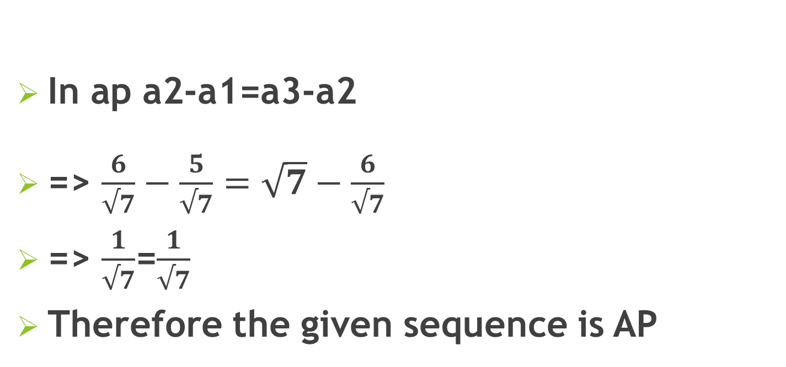
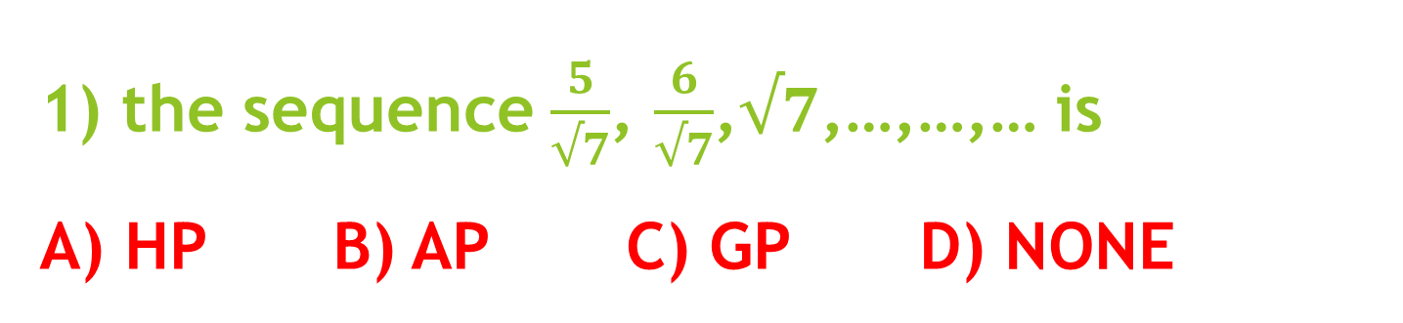
1) the sequence $\frac{5}{√7}$, $\frac{6}{√7}$,$√7$,…,…,… is A) HP B) AP C) GP D) NONE
In ap a2-a1=a3-a2
=> $\frac{6}{√7}−\frac{5}{√7}=\sqrt{7}−\frac{6}{√7}$
=> $\frac{1}{√7}$=$\frac{1}{√7}$
Therefore the given sequence is AP

Slide 10
2) The Sum Of Third And Ninth Term Of An A.P Is 8. Find The Sum Of The First 11 Terms Of The Progression A.44 B. 22 C.19 D. None
The third term t3 = a + 2d
The ninth term t9 = a + 8d
t3 + t9 = 2a + 10d = 8
Sum of first 11 terms of an AP is given by, S11 = 11/2 [2a + 10d] = 11/2 * 8 = 44

Slide 11
3.How many numbers between 11 and 90 divisible by 7? A.10 B.11 C. 12 D. 13
The required numbers are 14, 21, 28, … 84 This is an A.P with a = 14, d = (21-14) = 7
Let the number of terms be n, then Tn = 84
a + (n-1) d = 84 14 + (n-1) * 7 = 84 n = 11

Slide 12
4.The Sum Of 3rd And 15th Elements Of An Arithmetic Progression Is Equal To The Sum Of 6th, 11thAnd 13th Elements Of The Same Progression. Then Which Element Of The Series Should Necessarily Be Equal To Zero? A.1st B.9th C.12th D.7th
a + 2d + a + 14d = a + 5d + a + 10d + a + 12d
a + 11d = 0 --> 12th term

Slide 13
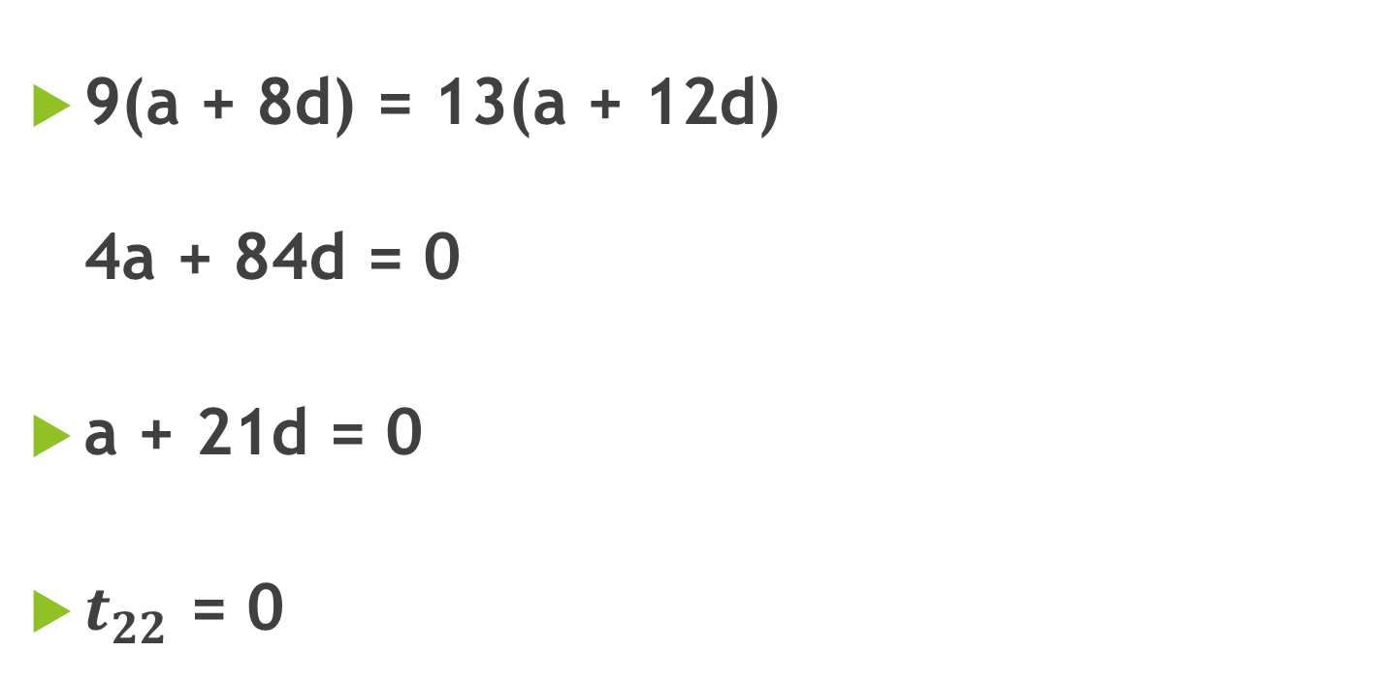
5.If 9 times 9th term of an AP = 13 times 13th term of same AP. which term is Zero?
9(a + 8d) = 13(a + 12d) 4a + 84d = 0
a + 21d = 0
$t_{22}$ = 0

Slide 14
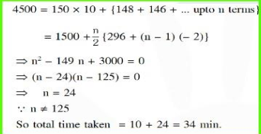
6.A Person Is To Count 4500 Currency Notes. Let A Denote The Number Of Notes He Counts In The Nth Minute. If A1 = A2 =……….=A10=150 And A10,a11,…. Are In An A.P. With Common Difference -2,then The Time Taken By Him To Count All Notes Is A. 24 Min B.34 Min C. 125 Min D.135 Min

Slide 15
7.How Many Terms Are Added In 24+20+16+ ....... Make The Sum 72. A. 9 B.10 C. 6 D. 7
We know that sum to first n terms of an A.P.
Sn = n/2 [2a + (n – l) d] Let the sum of n terms be 72, a = 24, d = -4
n/2(2a+(n-1)d)=72 ⇒n(48+(n-1)(-4))=144 ⇒n(-4n+52)=144 ⇒n(n-13)=-36 ⇒n^2-13n+36=0⇒n=4 & 9 n= 4 is ruled out and n=9 is the required answer.

Slide 16
8.What Is The Sum Of The First 15 Terms Of An A.P Whose 11th And 7th Terms Are 5.25 And 3.25 Respectively A. 56.25 B. 60 C. 52.5 D. None Of These
a +10d = 5.25 ---------(1) a+6d = 3.25 ----------(2) using (1) and (2) we get⇒4d = 2, d = ½ Put d = ½ in equation (1)
a +5 = 5.25
a = 0.25 = ¼,
S15 = 15/2 ( 2 * ¼ + 14 * ½ ) = 15/2 (1/2 +14/2 ) = 15/2 *15/2 =225/ 4 = 56.25

Slide 17
9.Sum Of First 25 Terms In AP Is 525, Sum Of The Next 25 Terms Is 725, What Is The Common Difference? A.8/25 B.4/25 C.6/25 D.1/25
Avg = Sum of terms / To no of terms
= 525/25
13th term = 21
a+12d = 21-------- 1
Avg = Sum of terms / To no of terms
= 725/25
38th term = 29
a+37d = 29-------2
Subract Eqn 1 from 2 25d = 8
d = 8/25

Slide 18
10.The Third Term Of A Finite Series In Arithmetic Progression Is 28. The Sum Of The First Three Terms Is 54. The First Term Of The Series Is: A.8 B.10 C.18 D. 2
Let the first term of an A.P. be ‘a’ and the common difference be ‘d’. Then the second term would be a + d and third term would be a + 2d. ∴ a + (a + d) + (a + 2d) = 54 ∴ 3a + 3d = 54 ∴ a + d = 18 … (i) And a + 2d = 28 … (ii) Solving (i) and (ii) for a and d, we get a = 8 and d = 10 ∴ The first term of this A.P. would be 8.

Slide 19
11.How Many Terms Are Identical In The Arithmetic Progressions 36, 72, 108, 144, … , 1584 And 48, 96, 144, 192, … , 1680
The first number which is common in both the A.P. is 144 and the number 144 is fourth number in the first progression.
In the first series there are 44 terms, so no of terms which are multiple of 144 is = 44/4 = 11 Example: 2,4,6,…..18 ( 2,4,6,8,10,12,14,16,18 )
3,6,9,…..27 ( 3,6,9,12,15,18,21,24,27 )

Slide 20
12.A Group Of 630 Children Is Arranged In Rows For A Group Photograph Session. Each Row Contains Three Fewer Children Than The Row In Front Of It. What Number Of Rows Is Not Possible? A.3 B.4 C.5 D.6
Let there be n rows,
Number of students in the first row = a ∴ Number of students in the second row = a + 3 ∴ Number of students in the third row = a + 6 and so on. ∴ The number of students in each row forms an arithmetic progression with a common difference = 3 Total no of students = The sum of all terms in the arithmetic progression ;
630 = n/2 ( 2a+(n-1)3)
1260= n(2a+(n-1)3) when n=3 a=207, n=4 a=153, n=5 a=120 n=6 a= 97.5. no of students cannot be the decimal

Slide 21
13.Consider The Set S = {1, 2, 3, …, 1000}. How Many Arithmetic Progressions Can Be Formed From The Elements Of S That Start With 1 And End With 1000 And Have At Least 3 Elements? A.3 B.4 C.6 D.7
Let there be n terms (n ≥ 3) in the arithmetic progression having 1 as the first term and 1000 as the last. Let d be the common difference.
Then, 1000 = 1 + (n – 1) × d ∴ 999 = (n – 1) × d ... (i) ∴ Factors of 999 are 1, 3, 9, 27, 37, 111, 333 and 999 Substituting in equation (i) If d = 1, n = 1000 If d = 3, n = 334 If d = 9, n = 112 If d = 27, n = 38 If d = 37, n = 28 If d = 111, n = 10 If d = 333, n = 4 If d = 999, n = 2, which is not possible as n > 2 ∴ 7 arithmetic progressions can be formed.

Slide 22
14. The Interior Angle Of Polygon Are In AP. The Smallest Angle Is 120 & The Common Difference Is 5. Find The Number Of Sides Of The Polygon.
Exterior angles are also in AP : a reducing AP start from 60 decrease by 5 so 60+55 + .....+20(9 terms ) will give us 360 degrees ...sum of exterior angles.....so 9 sides.

Slide 23
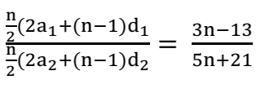

15.The Sum Of N Terms Of Two Series In AP Are In The Ratio (3n-13):(5n+21). Find The Ratio Of Their 24term. A.3:7 B.4:9 C.1:2 D.7:2
Now, the ratio of their 24th term is
To find this, compare this ratio with LHS of equation (1). we find that ⇒ n-1 = 46 => n = 47 therefore the ratio is 1:2

Slide 24
16.The Number Of Common Terms In The Two Sequences 17, 21, 25, … , 417 And 16, 21, 26, … , 466 Is A.78 B.19 C.20 D.77
Total number of terms in the sequence 17, 21, 25 …417 is 101 Total number of terms in the sequence 16, 21, 26 …466 is 91 n th term of the first sequence = 4n + 13 m th term of the second sequence = 5m + 11 4n + 13 = 5m + 11 5m - 4n = 2 Possible integral values of n that satisfy 5m = 2 + 4n are (2, 7, 12 …97) The total number of terms common in both the sequences is 20

Slide 25
17.Find The Sum Of All Two Digit Numbers Which When Divided By 4, Yield Unity As Remainder. A.1190 B.1197 C.1210 D.None
The given numbers are 13, 17, ..... 97. This is an AP with first term 13 and common difference 4. Let the number of terms be n. Then 97=13+(n-1)4 ⇒4n=88 ⇒n=22 Therefore the sum of the numbers =222[13+97]=11(110)=1210

Slide 26
18.How Many Terms Are There In The G.P. 4, 8, 16, 32, ... , 1024? A. 9 B. 8 C. 7 D. 6
a=4 ; r=4; tn=1024 tn=arn-1 ⇒1024=4×2n-1 ⇒2n-1=1024/4=256=28 ⇒2n-1=28 ⇒n-1=8 ⇒n=8+1=9

Slide 27
19.Sum Of First 12 Terms Of A GP Is Equal To The Sum Of The First 14 Terms In The Same GP. Sum Of The First 17 Terms Is 92, What Is The Third Term In The GP? A.92 B.-92 C.231 D.46
Choice B is the correct answer. Sum of first 12 terms is equal to sum of first 14 terms. Sum of first 14 terms = Sum of first 12 terms + 13th term + 14th term => 13th term + 14th term = 0 Let us assume 13th term = k, common ratio = r. 14th term will be kr. k + kr = 0 k (1 + r) = 0 => r = -1 as k cannot be zero Common ratio = -1 Now, if the first term of this GP is a, second term would be -a, third would be a and so on The GP would be a, -a, a, -a, a, -a,... Sum to even number of terms = 0 Sum to odd number of terms = a Sum to 17 terms is 92 => a = 92 Third term = a = 92

Slide 28
20) Which Term Of The GP : 2, 8, 32, ... Up To N Terms Is 131072 ?
Let 131072 be the nth term of the given G.P. Here a = 2 and r = 4. Therefore 131072 = an = 2(4)^(n – 1) or 65536 = 4^(n – 1) This gives 48 = 4^(n – 1) So that n – 1 = 8, i.e., n = 9. Hence, 131072 is the 9th term of the G.P

Slide 29

21.Find the sum of the sequence 7, 77, 777, 7777, ... to n terms
7 + 77 + 777 + 7777 + ... to n terms =7/9 [9 + 99 + 999 + 9999 to n terms] = 7/9[(10- 1)+ (10^2- 1) (10^3 -1) (10^4 -1) ... n terms];

Slide 30
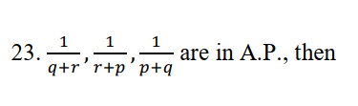

p,q,r are in A.P. B) P^2,q^2,r^2 are in A.P. C) 1/p,1/q,1/r are in A.P.
D) None
In A.P. a2 – a1 = a3 – a2
⇒2q^2=p^2+r^2 Therefore P2,q2,r2 are in A.P

Slide 31
Thank You!!!

